Slide 1
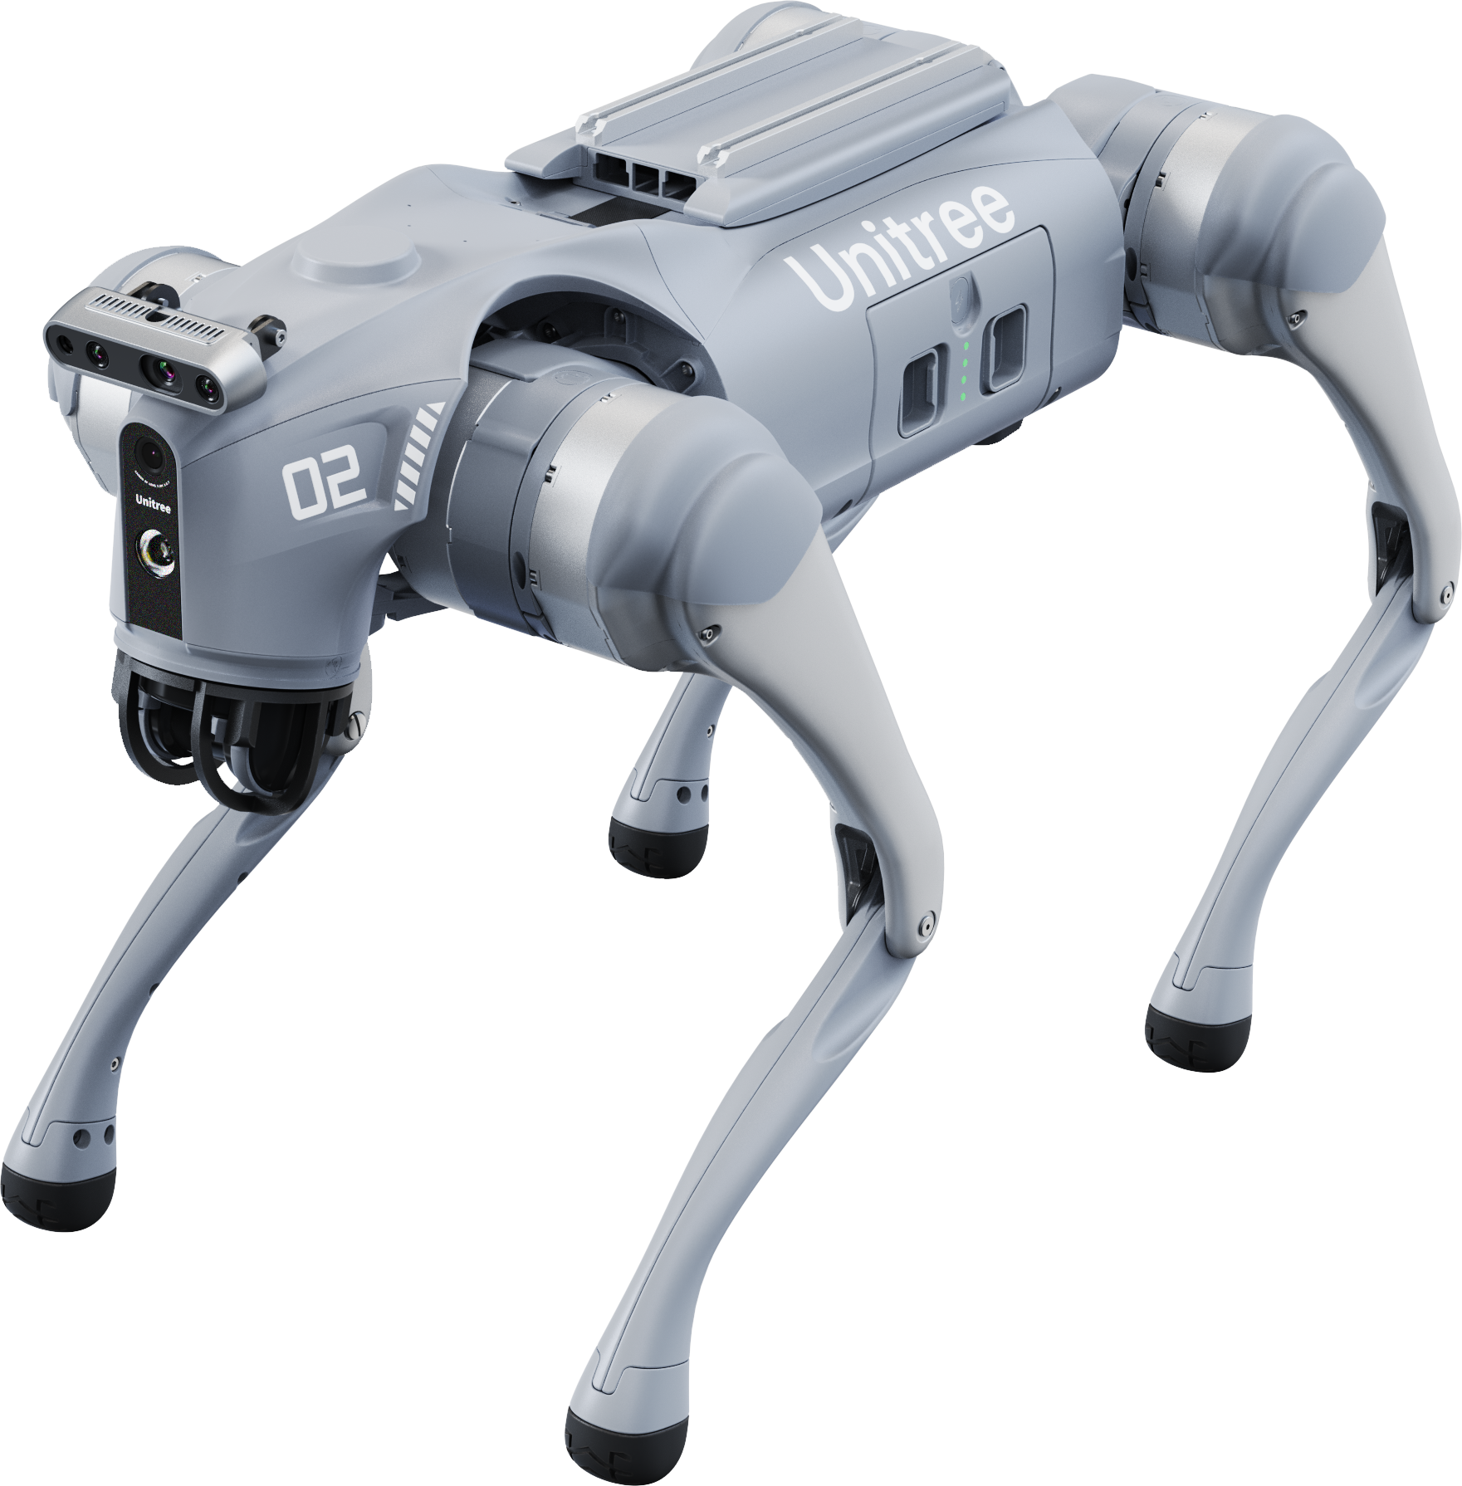














Gesture recognition
Unitree go2
FHGR institut für Robotics und Photonics
happy
jump
control
sit
down
love
greet
strech
dance
wave
hand stand
stand
pounce
bang
Safemode must be disabled. Keep clear of Robot!

